Slide 2
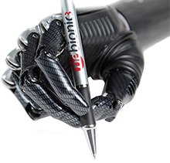
State-of-the-Art Designs
bebionic3 Hand – used as human prosthesis
Individual Motors in each finger. The motors are positioned to optimize weight distribution, making the hand feel lighter and more comfortable.
14 Selectable grip patterns and hand positions
Proportional Speed Control gives you precision control over delicate tasks, so you can pick up an egg as easily as crushing an empty can.
Durable construction and advanced materials makes
bebionic3 strong enough to handle up to 45kg
Selectable thumb positions
Innovative palm design protects bebionic3
from impact damage, and makes the hand
quieter thanever.
Soft finger pads that enhance grip.

Slide 3
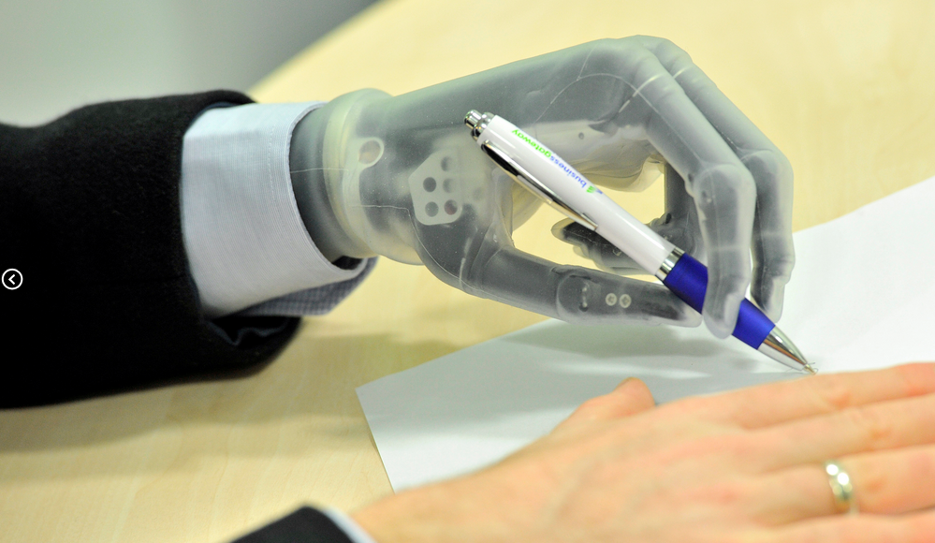
State-of-the-Art Designs
i-limb ultra revolution – used as human prosthesis
Powered rotating thumb
Five independently articulating digits with individual stall out ability. Each finger bends at the natural joints
A variety of flexible wrist options enabling more natural movement
New remote electrodes are
waterproof, lower profile,
and gold-plated for higher
sensitivity
Battery powered

Slide 4
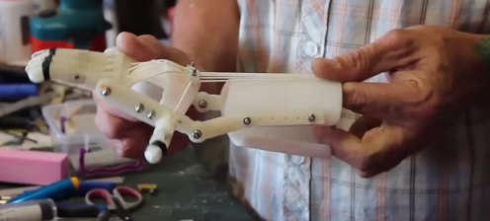
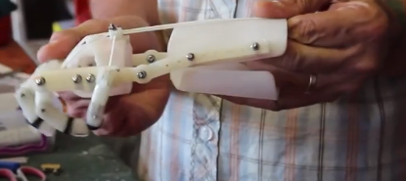
Existing Designs
RoboHand
Completely 3D printed except for three components
Bend wrist down to close fingers
Bend wrist up to release grip
Designed for people with no fingers

Slide 5
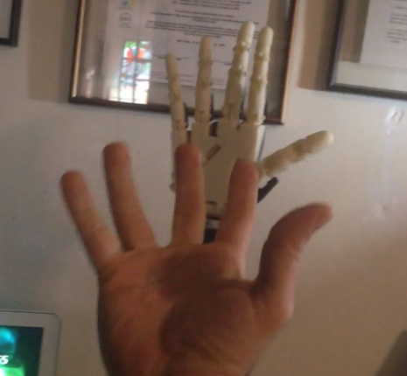
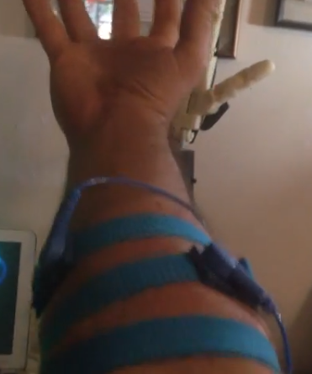
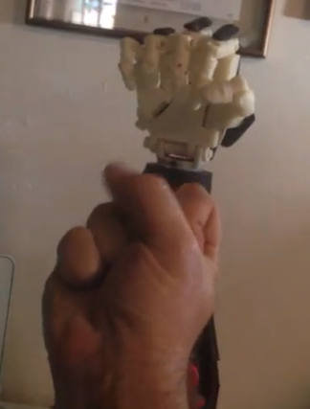
Existing Designs
InMoov
3D printed by a hobbyist
Uses motors and sensors

Slide 6
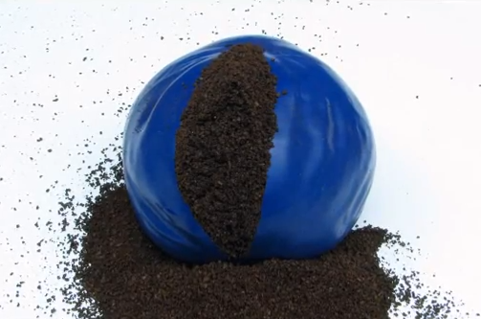
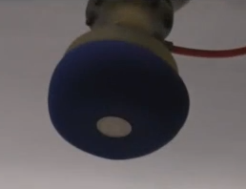
Granular Jamming
Coarse substance in a
flexible casing is soft
until air is removed
This can be used to
pick up or grip objects

Slide 7
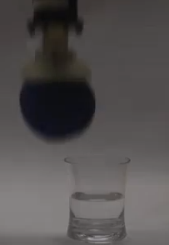
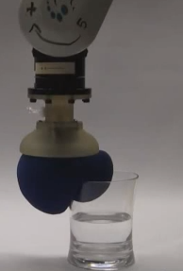
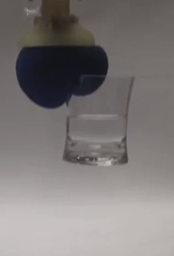
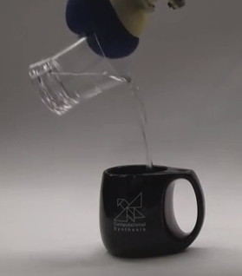
Granular Jamming In Action

Slide 8
Deliverables at end of Semester
Gain significant knowledge in the ___________ field
OpenSCAD will be used to create a complete prototype of the device in Phases II and III.
Finalized Bill of Materials
Understand and address the impact of the design in ethical, environmental, social, political, health and safety, sustainability, standardization/standards context

